Slide 1

よんでみよう！
リーディング チャレンジ

Slide 2
リーディング チャレンジ
ai
「エイ」

Slide 3
ai
「エイ」
「エイ」
「エイ」
mail
rain
「エイ」
「エイ」
tail
wait
「エイ」
「エイ」
train
pain

Slide 4
Remember!
i
「イ」
a
「ア」
a
i
e
「アイ」
e
「エイ」
ai
「エイ」

Slide 5
a and a_e
Reading cards: a /æ/ - /ei/ - Speaking cards
i and i_e
Reading cards: /i/ - /ai/. - Speaking cards
ai and i_e
Long a - i - Speaking cards

Slide 6

U8L1
This is my favorite place.

Slide 7
Unit goal
ユニットの目標
がっこう で いちばん すきな ばしょ を しょうかいしましょう。
Let’s introduce our favorite place in the school.

Slide 8
Today’s goal
今日の目標
きょうしつ の なまえ と しじ の よみかた を まなびましょう。
Let’s learn how to say classroom names and directions.

Slide 9
Then, tell me what English words did you hear?
せいか を きいて、 どんな えいたんご を きいた か おしえて ください。
Let’s listen to the chant.

Slide 10

PART
ONE
GIVING DIRECTIONS

Slide 11
GO STRAIGHT!
TURN RIGHT!
TURN LEFT!

Slide 12
ONCE MORE

Slide 13
GO STRAIGHT!
TURN RIGHT!
TURN LEFT!

Slide 14
Repeat after me…

Slide 15
Everybody stand up
Let’s play a game….
We have 3 Teams..
If someone makes mistake in your team, your team sit down..

Slide 16

SPOT THE DOG!

Slide 17
Play with your pair.
Find which direction is the dog?
Correct answer gets 1 point.
If both have correct
answers both get 1 point each.

Slide 18
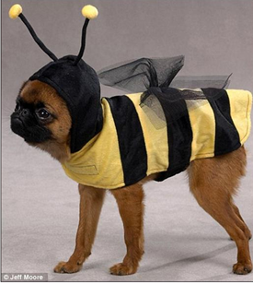

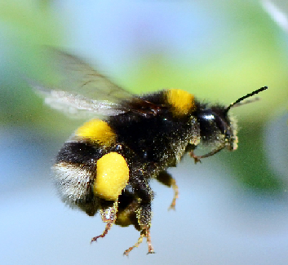
GO STRAIGHT!

Slide 19
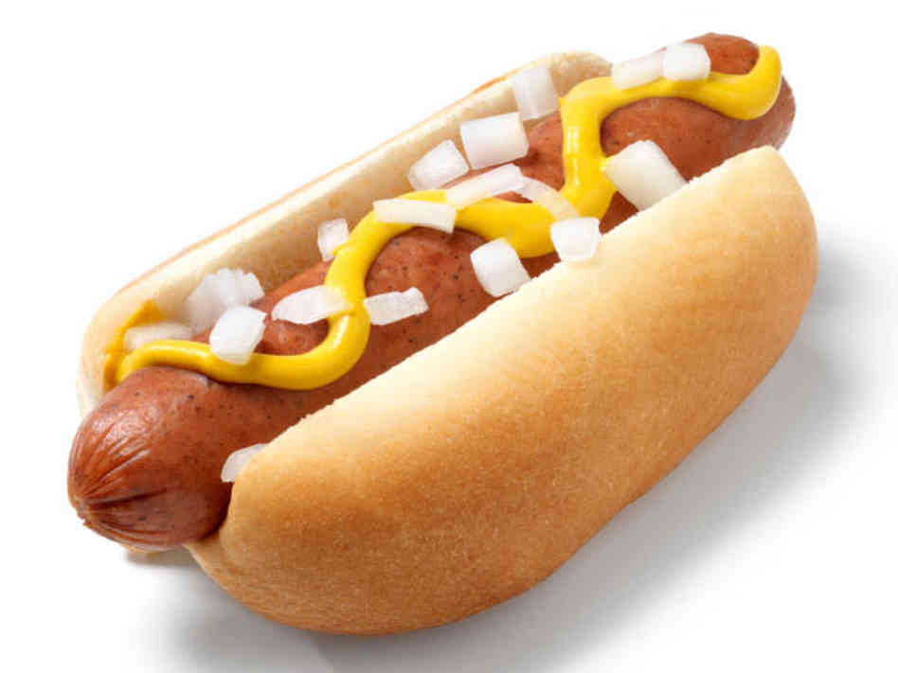

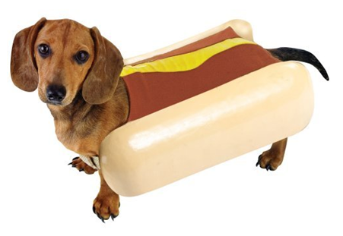
TURN RIGHT!

Slide 20
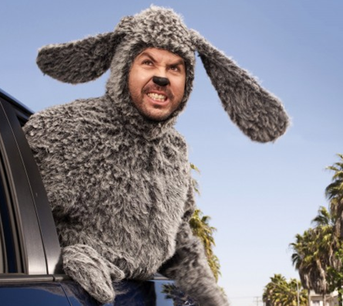

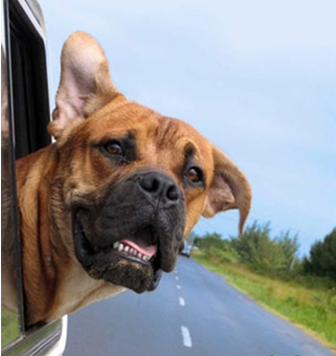
TURN LEFT!

Slide 21

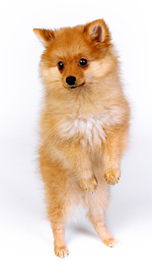
Turn right!

Slide 22
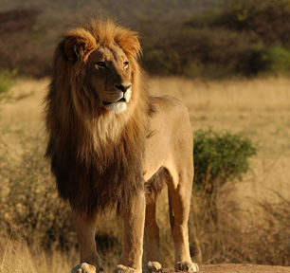
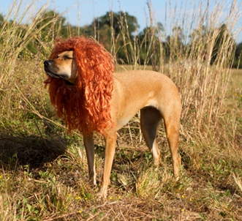
TURN LEFT!

Slide 23
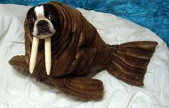
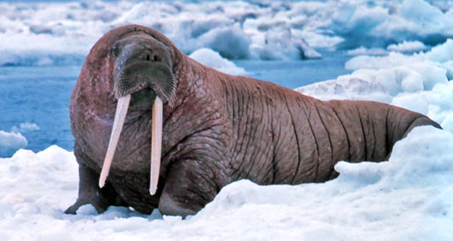
Go STRAIGHT!

Slide 24

Good Bye!
THE END

Slide 25

Notes:
What places or rooms are there inside the school?

Slide 26
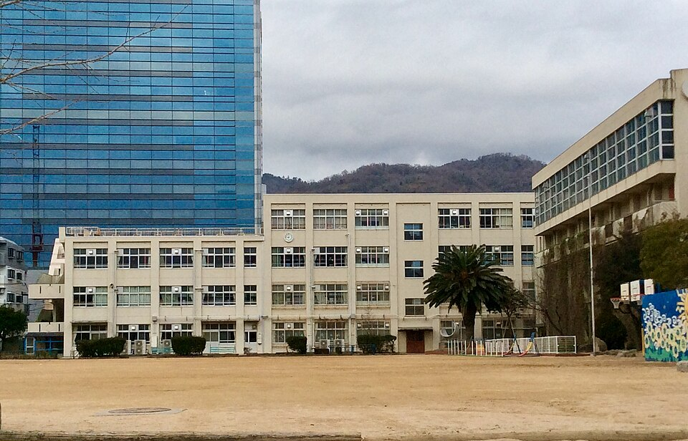
In Motoyama Minami Elementary school.
What classrooms here?

Slide 27
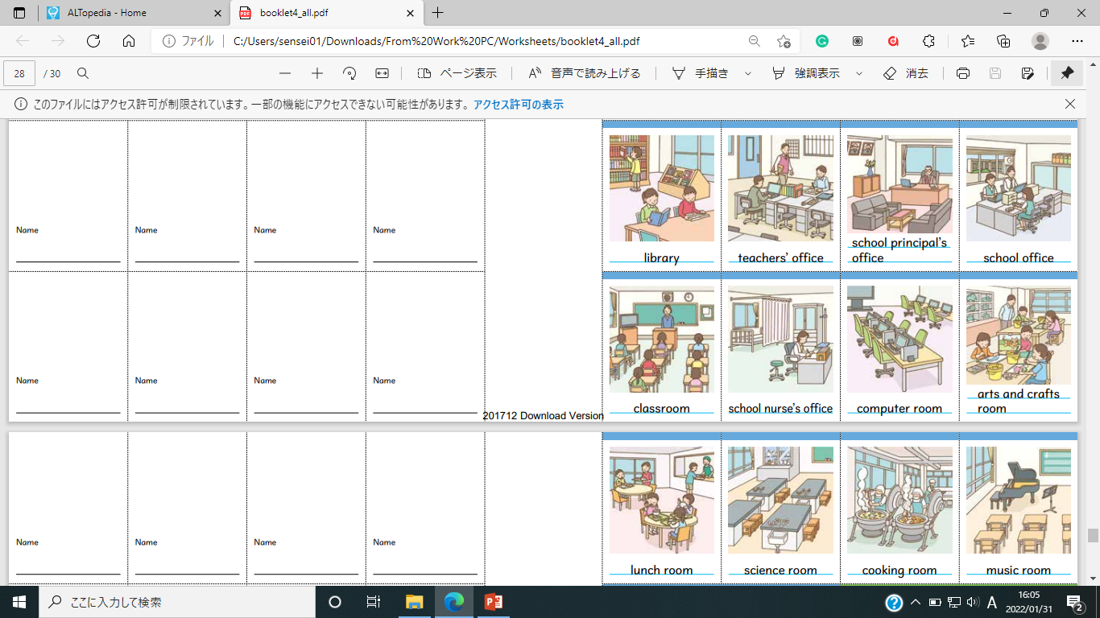
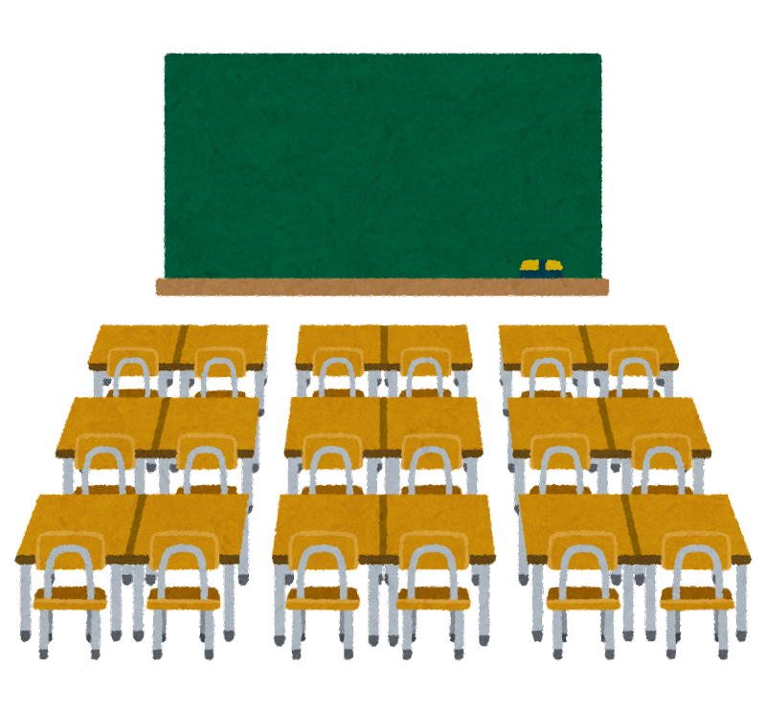

Slide 28
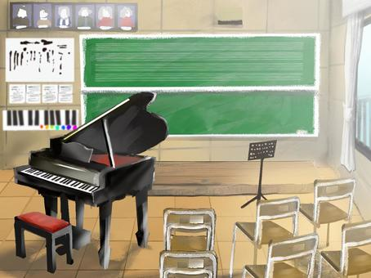

Slide 29

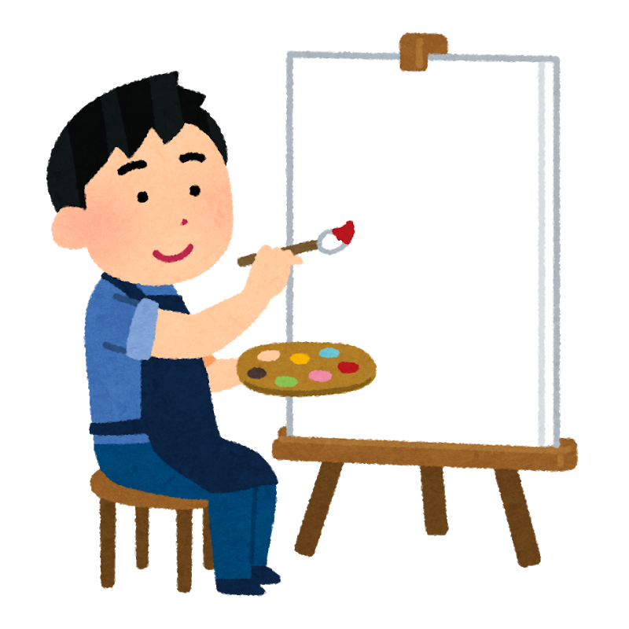

Slide 30


Slide 31
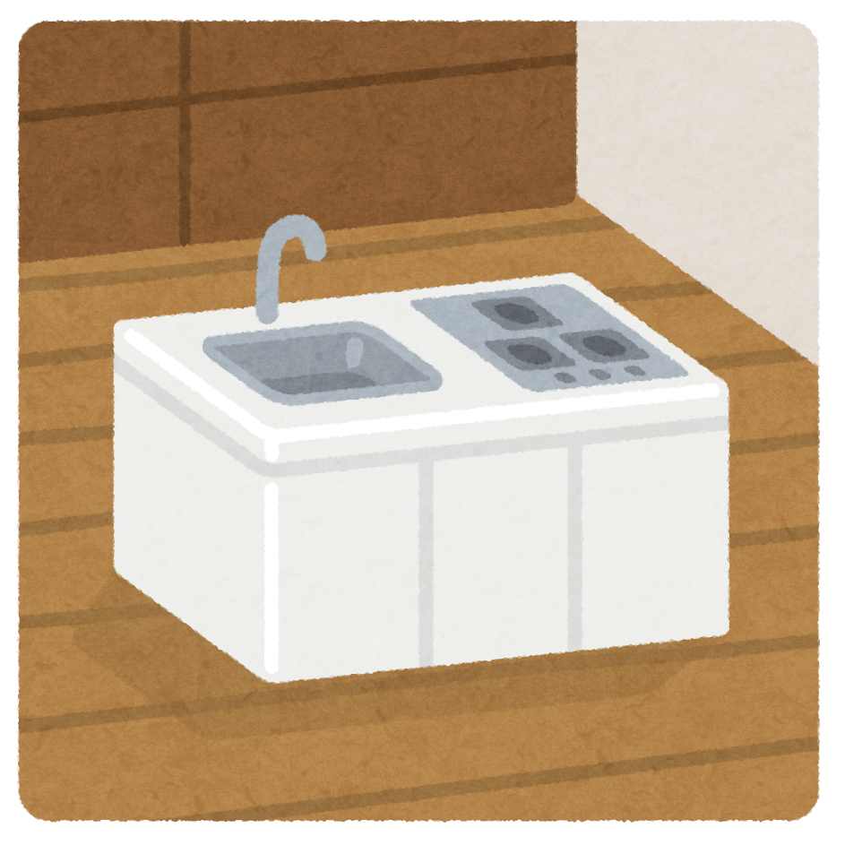

Slide 32


Slide 33
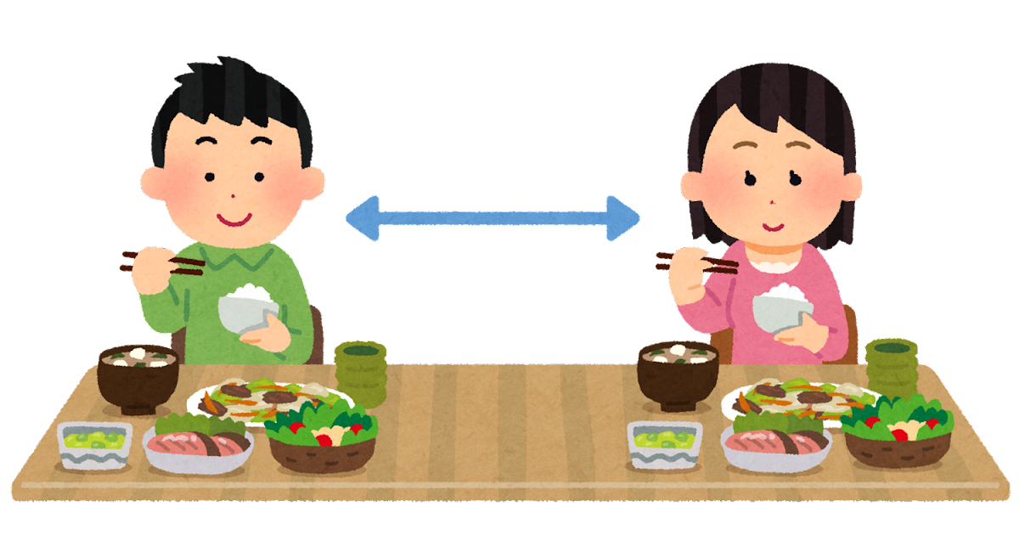

Slide 34
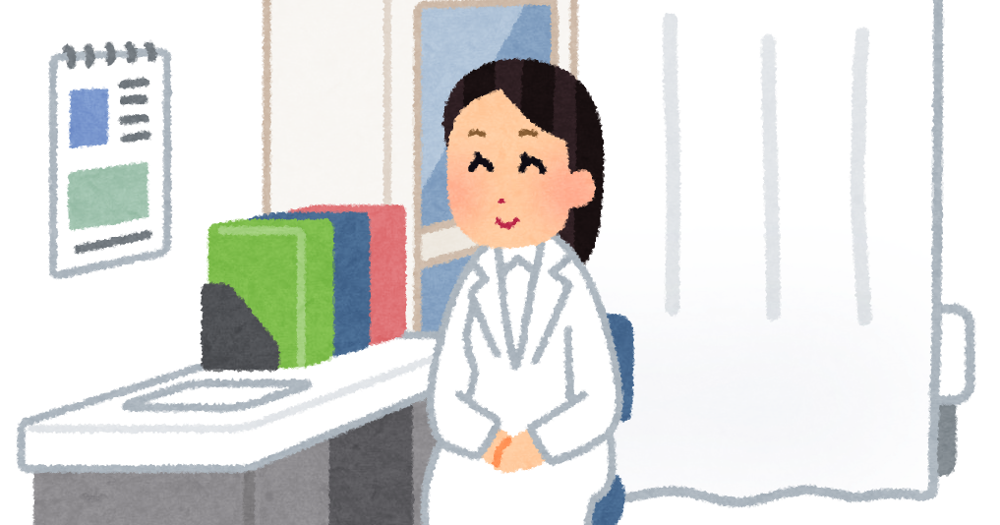


Slide 35

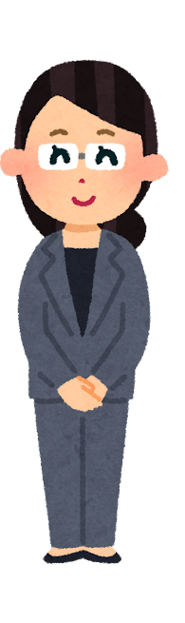

Slide 36
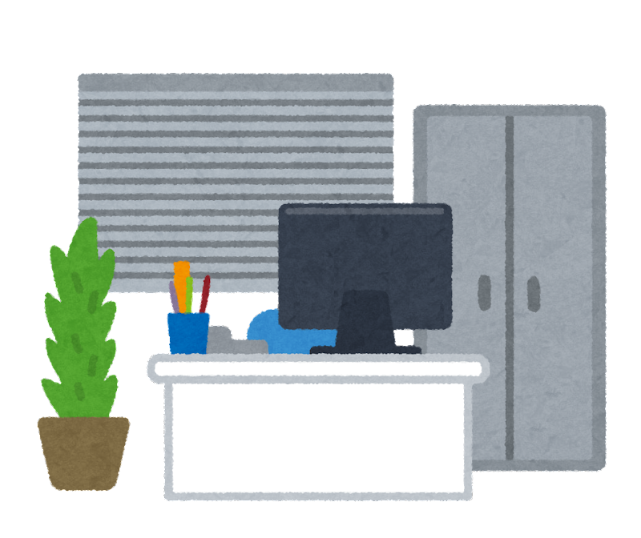

Slide 37
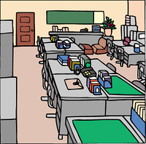

Slide 38


Slide 39
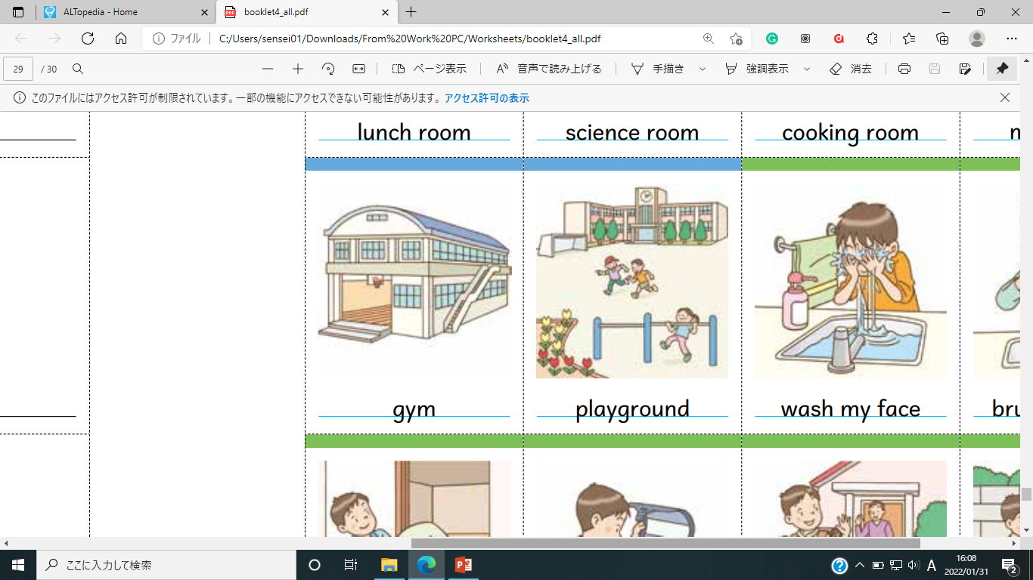
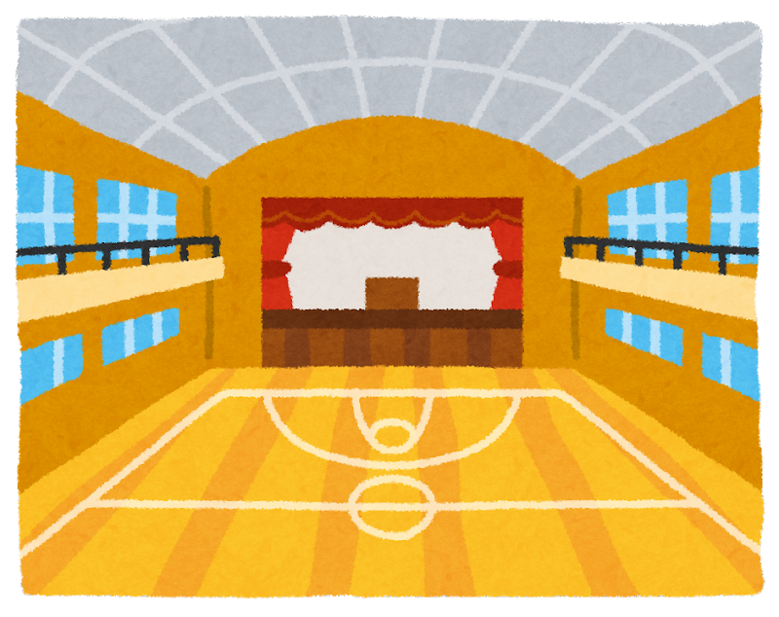

Slide 40
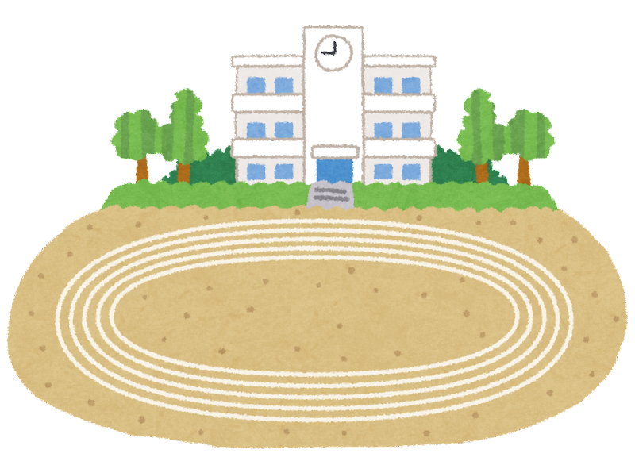

Slide 41
Let’s play
Missing Game

Slide 42
Play with your pair.
Guess the missing picture.
The first one to guess gets 1 point.
You can look at your textbooks.

Slide 43
Practice

Slide 44

Face on your desks.

Slide 46
Round 1

Slide 47
Face on your desks.

Slide 49
Round 2

Slide 50
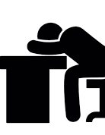
Face on your desks.

Slide 52
Round 3

Slide 53
Face on your desks.

Slide 55
Round 4

Slide 56
Face on your desks.

Slide 58
Round 5

Slide 59
Face on your desks.

Slide 61
L ESSON２

Slide 62
Today’s goal
今日の目標
きょうしつ の なまえ と しじ の よみかた を まなびましょう。
Let’s learn how to say classroom names and directions.

Slide 64


In Motoyama Minami Elementary school..
What’s your favorite place?

Slide 65
一番好き
場所
Guess my favorite place..

Slide 66
My favorite place is the...
一番好き
場所

Slide 67
How do you ask why in English?

Slide 68
Why?

Slide 69
Because …..

Slide 70
I like……

